Slide 1
Odoo Finance Accounting
Steps guide

Slide 2

Agenda
To provide step-wise execution process for payment and Invoicing
Fiscal Year closing [Period Locking]

Slide 3
Activities
Other Supplier Invoice Processing

Slide 4
Other Supplier Invoice Processing [Validation]
Actors
Finance Users [Doreen, Innocent Kisuge]
Purpose
Create Vendor bills [Other than the Automated Bills]
Description
To create the vendor bill Finance user need to go into the Accounting > Purchase > Documents > vendor.
In the Bill, user can select the Correct vendor, Products and Taxes and save the bill.
If users already have the physical copy of the bill, then it is recommended to add the reference in the Vendor Reference section.
Once the bill is created [With correct currency and Values], user can validate the bill.
Once the Bill is Validated, the Value in the Account Payables will increase, And in system Following Entries will be passed.
Account | Debit | Credit
Account Payable - Payable to other Parties |  | xxxxx.xx
Expenses [Purchase] | xxxx.xx

Slide 5
Activities
Other Supplier Payment Processing

Slide 6
Payment Processing
The payment for Invoice can be done in multiple ways in ERP
Through the Register Invoice Button in Vendor Bills.
Consolidated single payment against multiple Invoices.
Payments by posting payments separately and manually matching with the Invoices.

Slide 7
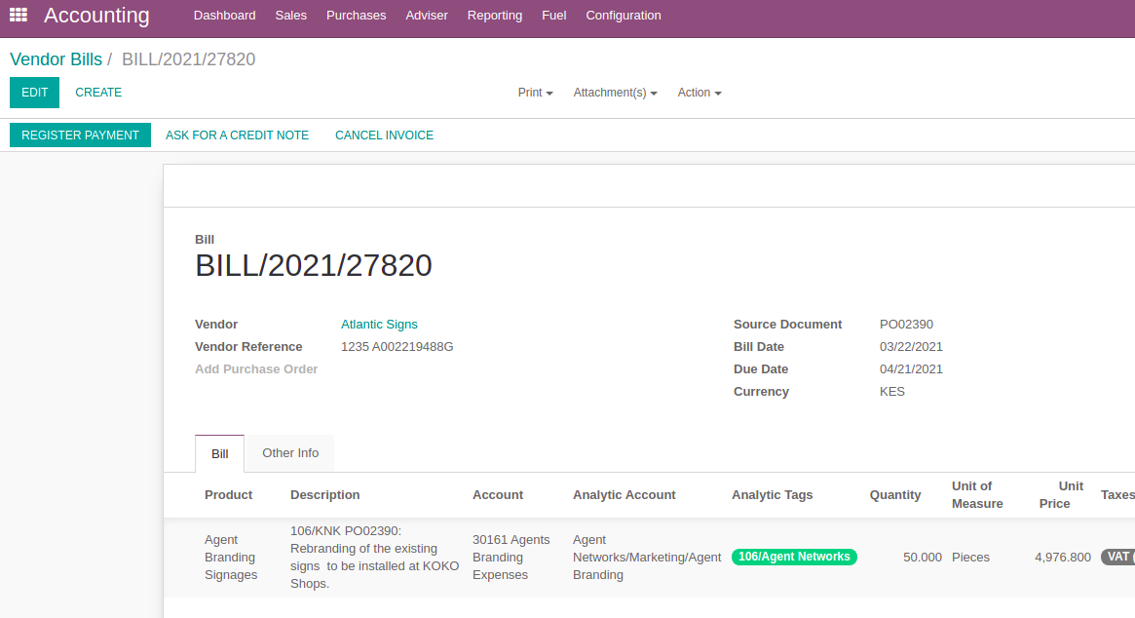
Payment Processing (Single Invoice at a time)
Through the Register Invoice Button in Vendor Bills.
This process can be executed in 2 steps.
Click the button for the Register Payments, in the Validated Vendor Bills.

Slide 8
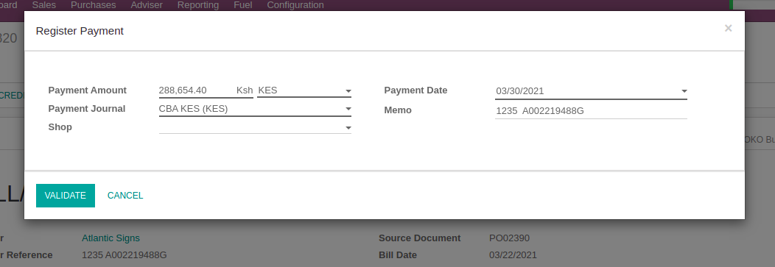
Payment Processing (Single Invoice at a time)
Once user clicks the Register Payment Button, they will get a POP -Up, to select the Payment Journal and validate the Payment.
Once Validate button is clicked, the Vendor bill move to the Paid state. [If the full amount is selected in the Payment Amount]

Slide 9
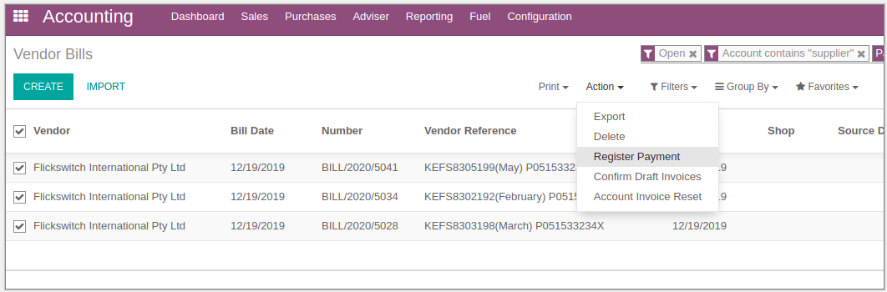
Payment Processing (Multiple Invoicing at a time)
Consolidated single payment against multiple Invoices.
Through this option user can select multiple vendor bills [For a any specific vendor] from the list view, and create one payment to settle them all.
Once the user clicks on the Register payment option, the POP up will come up with the total due amount to be paid from all of the selected invoices.

Slide 10
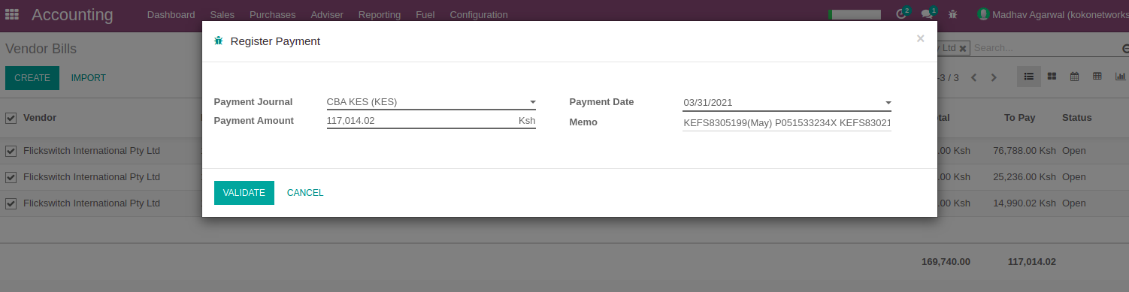
Payment Processing (Multiple Invoicing at a time)
As user can see in the below screen, the total due amount is picked up automatically by the system. on clicking on the “Validate” button, all the selected invoices will be paid.
Note: Through this feature users cannot process the partial payments for any invoice.

Slide 11
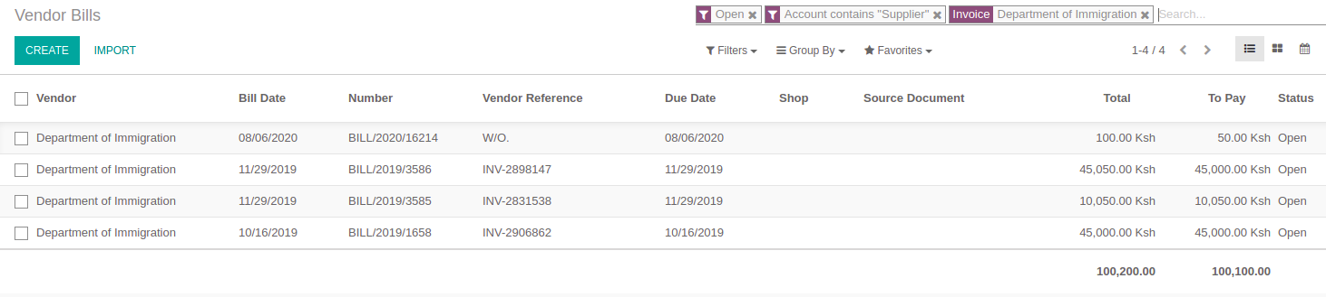
Payment Processing (Multiple Invoicing at a time)
Payment processing by creating payment separately and Matching invoices afterwards.
Through this process users can create one Payment and reconcile required invoices based on requirement. [This process also allows partial payments]
E.g To pay the following invoices, user will create one payment and reconcile that further.

Slide 12
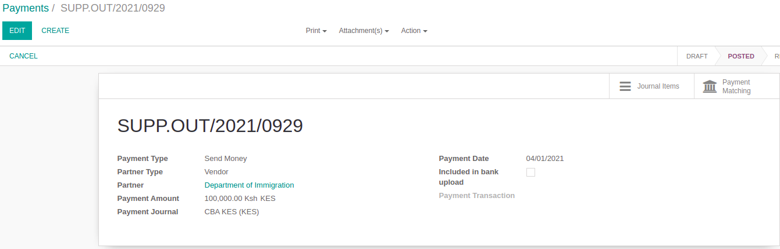
Payment Processing (Multiple Invoicing at a time)
E.g To pay the following invoices user will create one payment for 100,1000 Kes.
Once the Payment is created and Posted, User can see the option for Payment Matching.

Slide 13
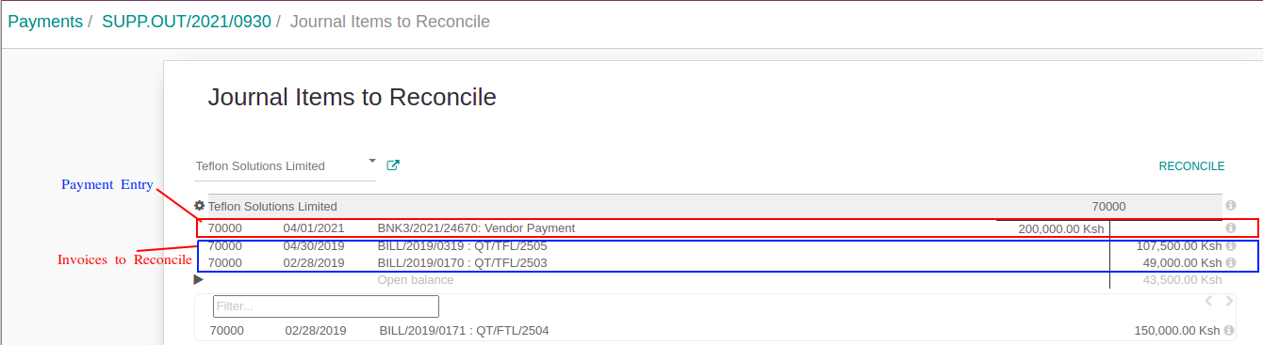
Payment Processing (Multiple Invoicing at a time)
When user click on the “Payment Matching” button they will get the following screen:
Once the invoices to pay are selected, user can click on the reconcile button, to complete the payment reconciliation.
After above step, the selected invoices will be in Paid state.

Slide 14
Activities
Period Closing

Slide 15
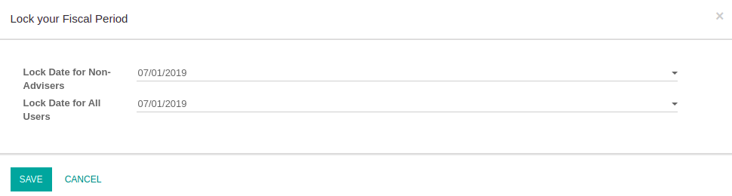
Period Closing [Lock Fiscal Period]
Actors
Account Managers (with Advisor Role in ERP system).
Purpose
To Lock the fiscal period in the system.
Description
ERP system provides us the ability to lock the period in finance module.
Through this users can make sure that the users [Finance or Others] are not able to post any finance transaction in the locked period to maintain the data sanity in the system.
System also provides us the option to select different lock dates for Finance Users and the other users.
users can set this up through following places.
Navigate to Accounting > Adviser > Actions > Lock Dates and set the date in the below POP up.

Slide 16
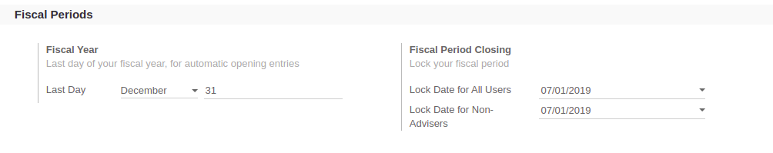
Period Closing [Lock Fiscal Period]
Users can also navigate to Accounting > Configurations > Settings > Fiscal Period Closing and set the dates here.

Slide 17
Madhav Agarwal and Tim Muchai
m.agarwal@kokonetworks.com / t.muchai@kokonetworks.com

